Slide 1

Email AutoLabeler
Automatically Label Emails
Without User-Defined Criteria
AutoLabeler
Rong Li
rl.rongli@gmail.com
Notes:
Hi my name is Rong Li. I designed an email autolabeler which can automatically label emails according to customized topics without user defined criteria.

Slide 2



Unorganized Inbox: Disaster! Manually Labeling: Troublesome!
Notes:
Let’s say this is Louise. She receives tens or even hundreds of emails everyday. She needs to label her emails with customized topics to keep her inbox organized. Manually labeling emails takes her a lot of time and efforts, so she turns to the gmail filter for help.

Slide 3

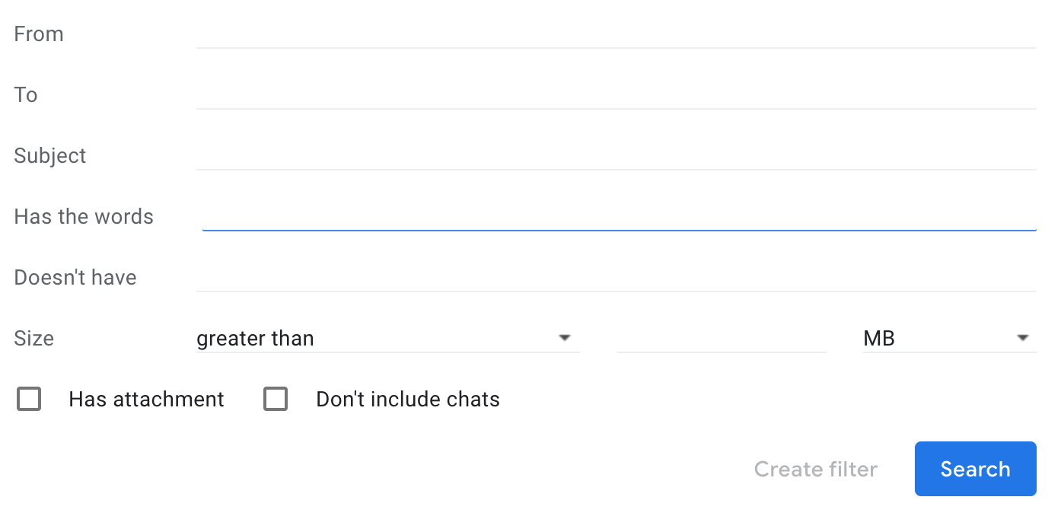
Gmail Filter: Users Define Criteria!
Notes:
Louise found the gmail filter requires her to define filtering criteria such as senders, subjects, whether the emails contain some particular words or not. It can’t solve Louise’s problem, since Louise wants to label her emails according to customized topics.

Slide 4
Can Gmail Filter Handle Cases Like This?
Two emails with the same ‘Finance’ label
Different
senders
From: Joseph Deffner
To: Louise Kitchen
From: David Gorte
To: Louise Kitchen
Notes:
Because Louise wants to label her emails with customized topics. Just like these two emails. They both should be labeled with the topic ‘finance’. But they were sent from different senders, have different subjects, and do not contain any common keywords.

Slide 5
Can Gmail Filter Handle Cases Like This?
Two emails with the same ‘Finance’ label
Different
senders
From: Joseph Deffner
To: Louise Kitchen
Subject: Funds Flow Targets
From: David Gorte
To: Louise Kitchen
Subject: Updated NEPCO Data
Different subjects
Notes:
Just like these two emails. Louise wants to label both of them with the topic ‘finance’. But they were sent from different senders, have different subjects, and do not contain any common keywords.

Slide 6
Can Gmail Filter Handle Cases Like This?
Two emails with the same ‘Finance’ label
Different
senders
From: Joseph Deffner
To: Louise Kitchen
Subject: Funds Flow Targets
It should be priced more like prm activity than pure debt if it is to attract a capital charge.
From: David Gorte
To: Louise Kitchen
Subject: Updated NEPCO Data
I have included expected project profitability in the comments section of the attached.
Different subjects
No common
topic words
Notes:
Just like these two emails. Louise wants to label both of them with the topic ‘finance’. But they were sent from different senders, have different subjects, and do not contain any common topic words. So the gmail filter is not flexible enough to solve this kind of problem.

Slide 7

Can Gmail Filter Handle Cases Like This?
Different
senders
From: Joseph Deffner
To: Louise Kitchen
Subject: Funds Flow Targets
It should be priced more like prm activity than pure debt if it is to attract a capital charge.
From: David Gorte
To: Louise Kitchen
Subject: Updated NEPCO Data
I have included expected project profitability in the comments section of the attached.
Different subjects
No common
topic words
Notes:
Just like these two emails. Louise wants to label both of them with the topic ‘finance’. But they were sent from different senders, have different subjects, and do not contain any common topic words. For this kind of cases, the gmail filter is not flexible enough to do the work. That is why I would like to design this email autolabeler.

Slide 8
Email AutoLabeler: Flexible and Smarter
Notes:
Email Autolabeler is a flexible and smarter tool to label emails with customized topics.

Slide 9
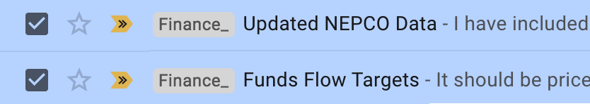
Email AutoLabeler: Flexible and Smarter
Create label ‘Finance’ and apply to old emails
Notes:
When using the Autolabeler, Louise just need to create a label “ finance”, then apply this label to a bunch of old emails. Then the Autolabeler can extract common features from these old emails. When a new email arrives, Autolabeler can automatically decide whether the label applies to the new email.

Slide 10
Email AutoLabeler: Flexible and Smarter
Create label ‘Finance’ and apply to old emails
AutoLabeler
Auto-Learned Criteria!
Notes:
When using the Autolabeler, Louise just need to create a label “ finance”, then apply this label to a bunch of old emails. Then the Autolabeler can extract common features from these old emails automatically. When a new email arrives, Autolabeler can decide whether the label applies to the new email.

Slide 11
Email AutoLabeler: Flexible and Smarter
New email arrives
Create label ‘Finance’ and apply to old emails
AutoLabeler
Notes:
When using the Autolabeler, Louise just need to create a label “ finance”, then apply this label to some old emails. Then the Autolabeler can extract common features from these old emails. When a new email arrives, Autolabeler can automatically decide whether the label applies to the new email.

Slide 12

Email AutoLabeler: Flexible and Smarter
New email arrives
Create label ‘Finance’ and apply to old emails
AutoLabeler
New email labeled
Notes:
When using the Autolabeler, Louise just need to create a label “ finance”, then apply this label to some old emails. Then the Autolabeler can extract common features from these old emails. When a new email arrives, Autolabeler can automatically decide whether the label applies to the new email.

Slide 13

Email AutoLabeler Pipeline
Data Input
Data Cleaning and Feature Engineering
Model
Parse Email Contents
Email
Message
Subject, Related Parties (From, To, CC, Bcc), Body
Notes:
When the new email arrives, the autolabeler will first parse the email to get subject, from, to, and email body text. Then send these information to the NLP preprocessor to get a word list. Then use the Tfidf vectorizer to get a feature number vector, and select most important features from them. Then send these features to the MLP classification model to get email labeled.

Slide 14


Email AutoLabeler Pipeline
Data Input
Data Cleaning and Feature Engineering
Model
Parse Email Contents
Preprocess
(Tokenization, Stop words removal, Lemmatization, Stemming)
Email
Message
Subject, Related Parties (From, To, CC, Bcc), Body
Processed word list
Notes:
When the new email arrives, the autolabeler will first parse the email to get subject, from, to, and email body text. Then send these information to the NLP preprocessor to get a word list. Then use the Tfidf vectorizer to get a feature number vector, and select most important features from them. Then send these features to the MLP classification model to get email labeled.

Slide 15

Email AutoLabeler Pipeline
Data Input
Data Cleaning and Feature Engineering
Model
Parse Email Contents
Preprocess
(Tokenization, Stop words removal, Lemmatization, Stemming)
Feature Extraction
(TF-IDFvectorizer, SelectKBest)
Email
Message
Subject, Related Parties (From, To, CC, Bcc), Body
Processed word list
Number vectors
Notes:
When the new email arrives, the autolabeler will first parse the email to get subject, from, to, and email body text. Then send these information to the NLP preprocessor to get a word list. Then use the Tfidf vectorizer to get a feature number vector, and select most important features from them. Then send these features to the MLP classification model to get email labeled.

Slide 16


Email AutoLabeler Pipeline
Data Input
Data Cleaning and Feature Engineering
Model
Parse Email Contents
Preprocess
(Tokenization, Stop words removal, Lemmatization, Stemming)
Feature Extraction
(TF-IDFvectorizer, SelectKBest)
Classification
Multilayer perceptron (MLP)
Email
Message
Subject, Related Parties (From, To, CC, Bcc), Body
Processed word list
Number vectors
Labeled email
Notes:
When the new email arrives, the autolabeler will first parse the email to get subject, from, to, and email body text. Then send these information to the NLP preprocessor to get a word list. Then use the Tfidf vectorizer to get a feature number vector, and select most important features from them. Then send these features to the MLP classification model to get email labeled.

Slide 17
Customized Classification Model for Each User
Enron email dataset: 500,000+ from 150 employees
Name # of Emails
Steven 14505
Vincent 4481
Louise 4033
Darren 3786
Notes:
My data set includes over 500,000 emails from 150 Enron employees.

Slide 18

Customized Classification Model for Each User
Louise’s labeled emails: 4000+
Labels # of Emails
esvl 715
mrha/ooc 309
hr 306
east_power 257
Enron email dataset: 500,000+ from 150 employees
Name # of Emails
Steven 14505
Vincent 4481
Louise 4033
Darren 3786
Notes:
Since each user defined their own customized labels, this classification model needs to be specially built for each individual user. Since Louise asked for help, I built a model for her based on her over 4000 emails.

Slide 19
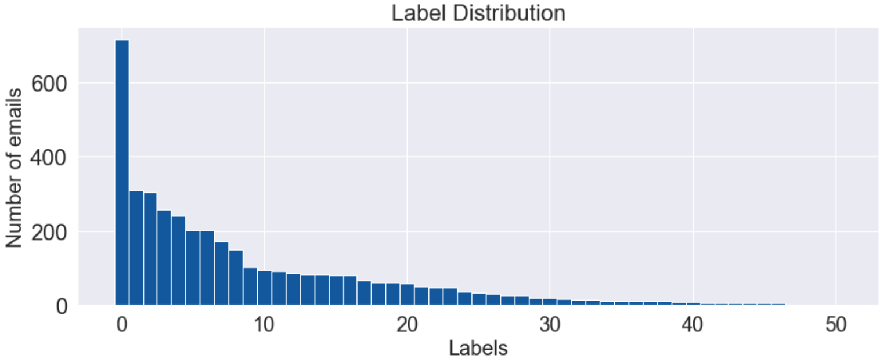
Imbalanced Label Distribution
Notes:
I found Louse’s inbox has 51 customized labels, and the number of emails in each label ranges from over 700 emails to just 1 email in one label. So this causes severe imbalanced data problem.

Slide 20
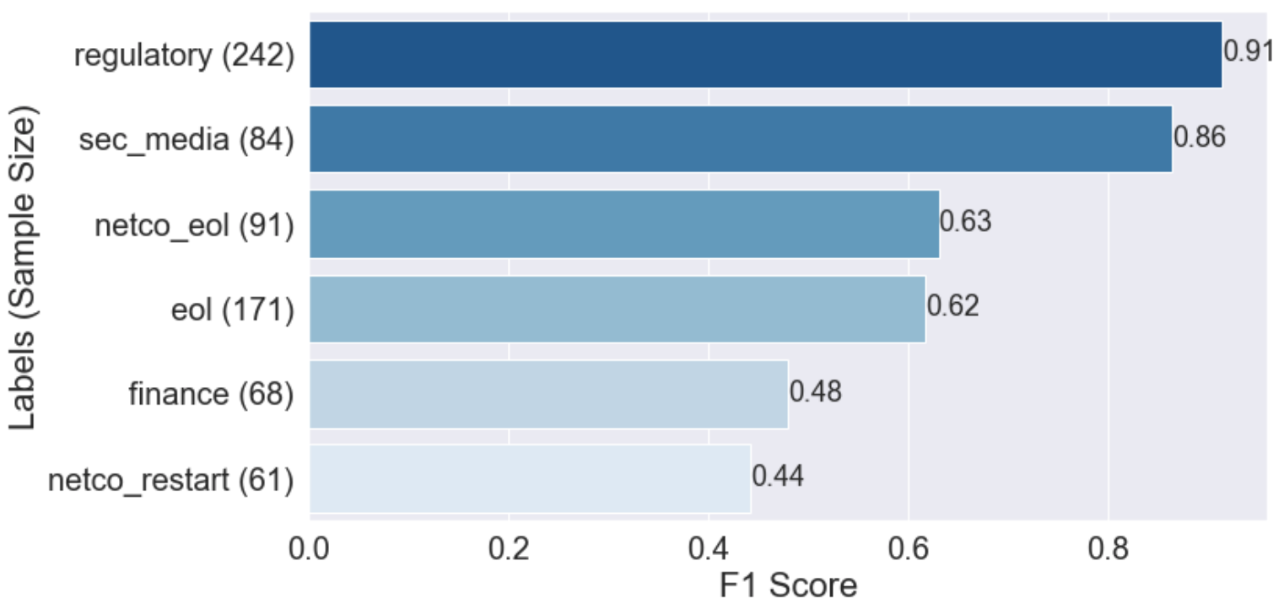
It Works Even for Labels of Medium Size
Macro F1 Score: 0.67
Notes:
The result shows that the Autolabeler works well for some labels, the best F1 score is 0.91. It even works for the folders which just includes 80 emails.

Slide 21
Similar Topics Make Classification Harder
Macro F1 Score: 0.67
Notes:
But when two labels have similar topics, like this shows, the performance may be affected. But it may be further improved if a parent label is created for these two labels, and the AutoLabeler first decides whether the parent label applies to the new email, if yes, then decides which sublabel should apply.

Slide 22
Small Sample Size May be a Problem
Macro F1 Score: 0.67
Notes:
The last two rows show that small sample size may give poor performance. But it may be improved as new emails come in and the sample size grows.

Slide 23
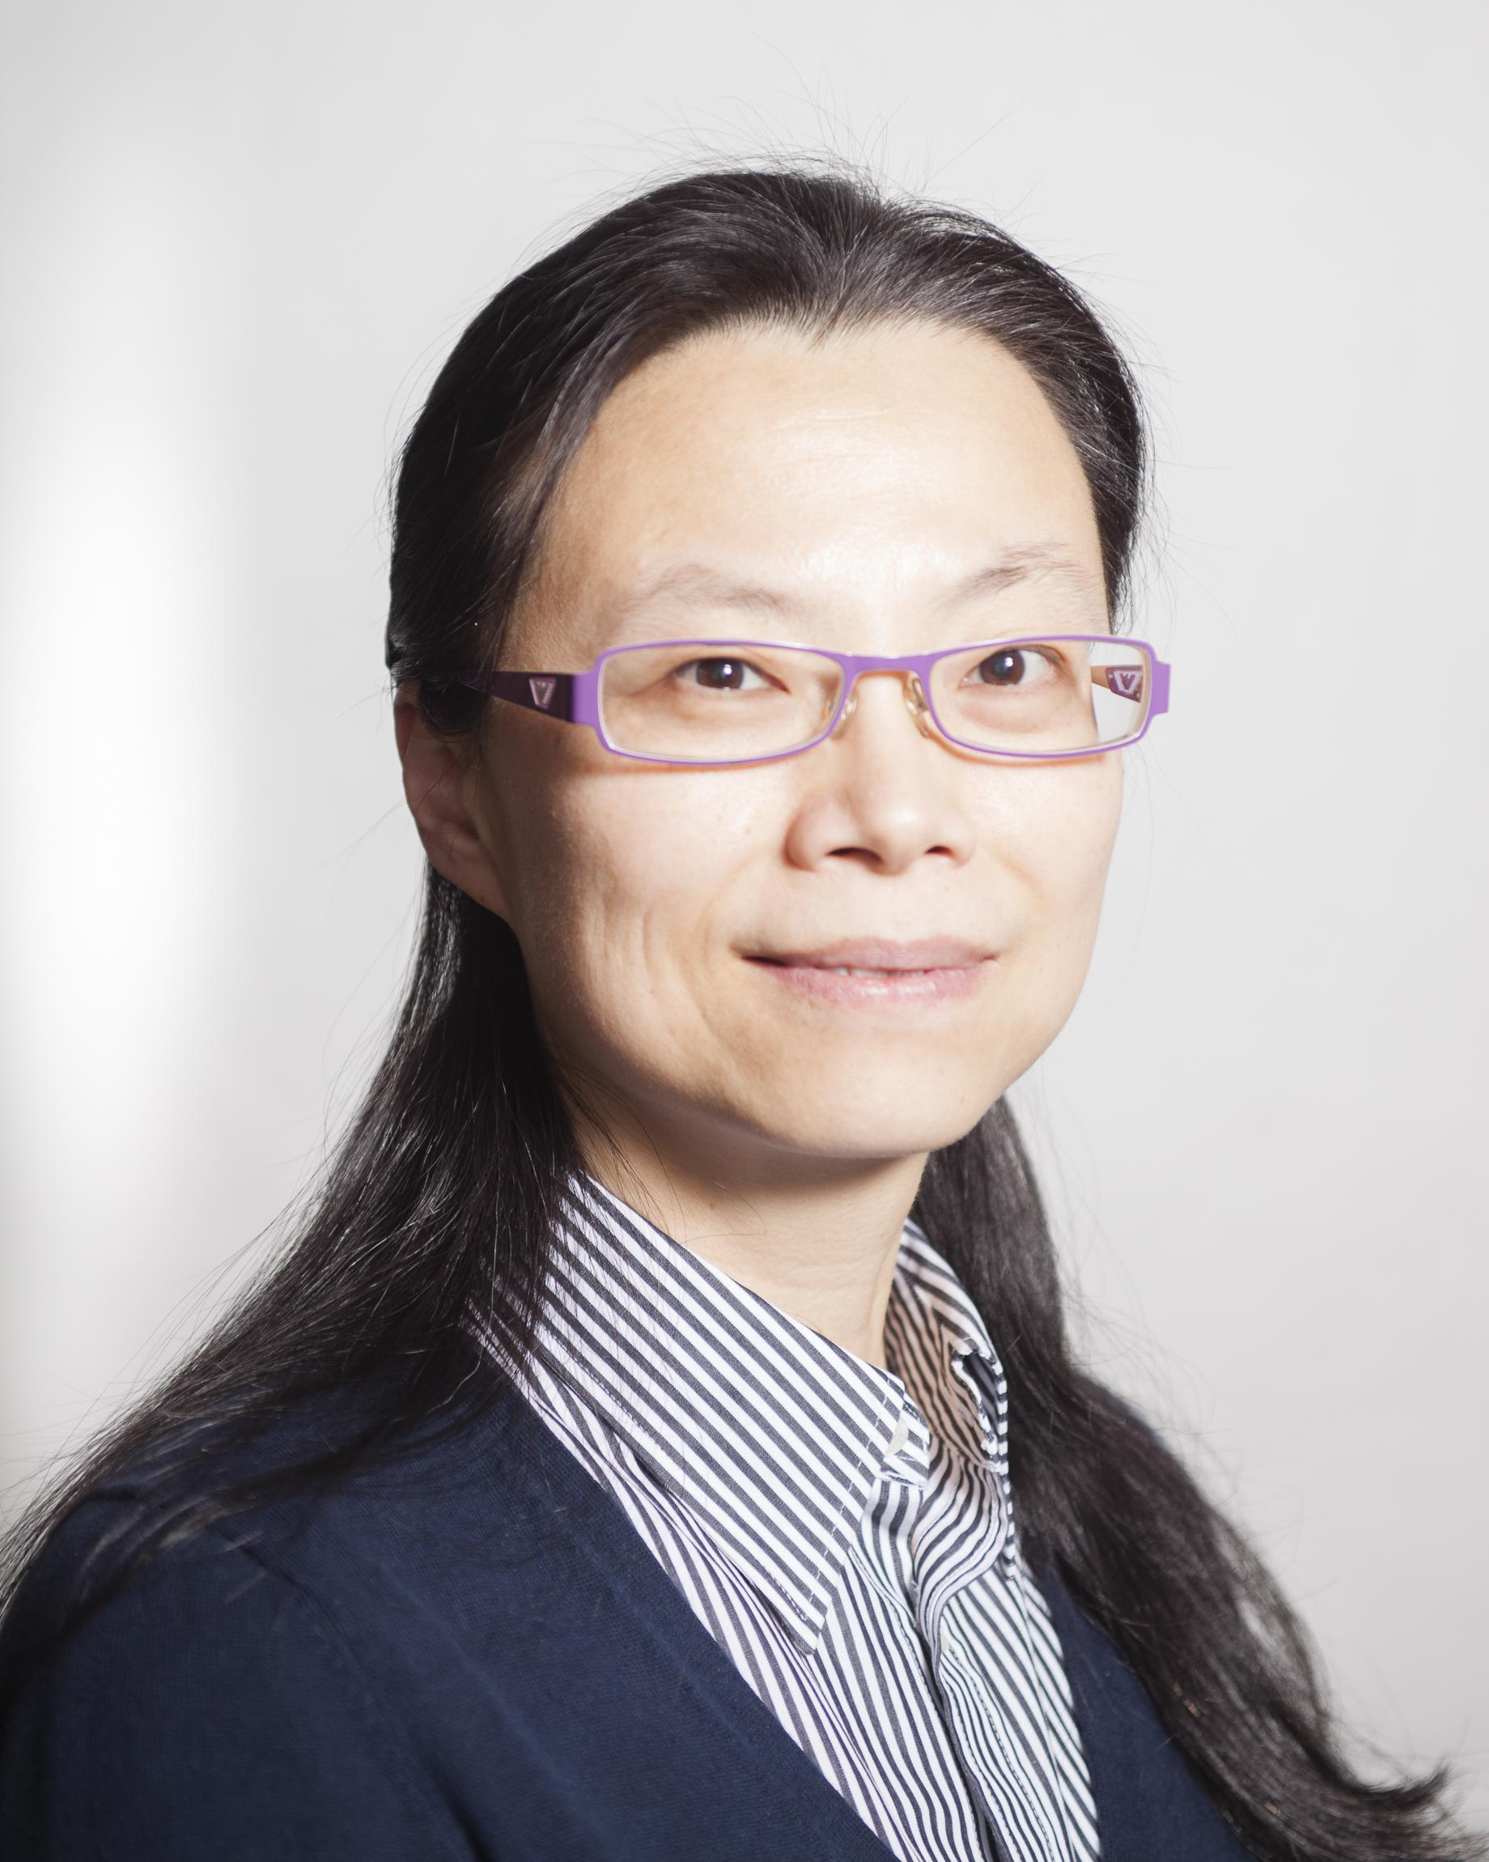
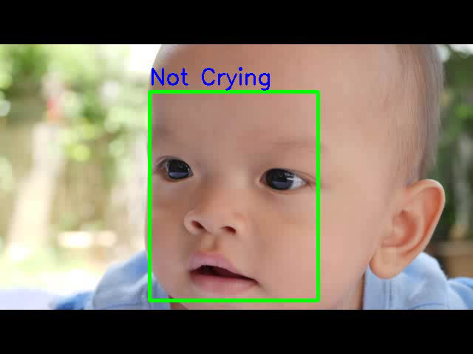
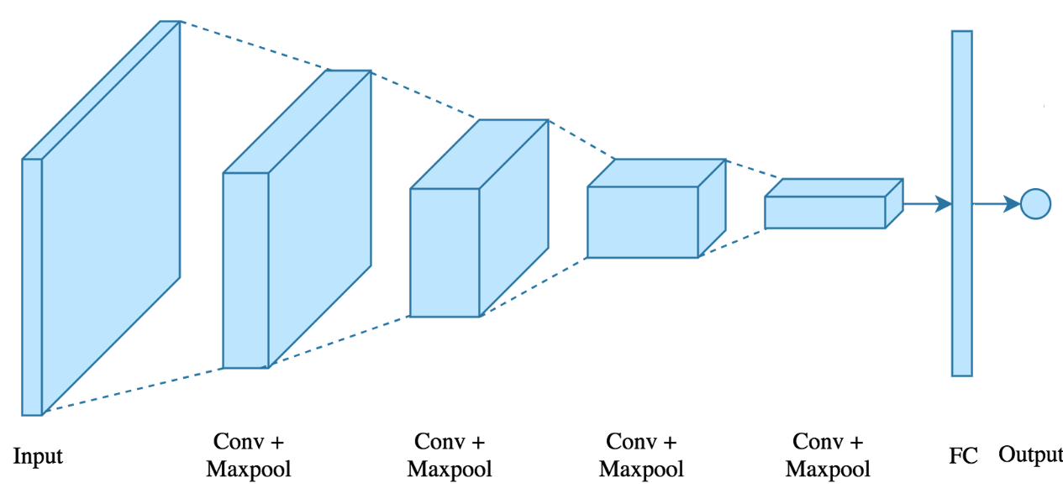


Rong Li
Ph.D in Electrical and Computer
Engineering
Data Scientist Intern at D4DT
rl.rongli@gmail.com
Notes:
So this is me, Rong Li. I got my Ph.D in Electrical and Computer Engineering from NUS. I was a Data Scientist intern at D4DT. There I designed some time series forecasting algorithms to predict fuel consumption rate based on truck sensor readings. These time series experience will also be useful for ActZero, since ActZero also needs to monitor some time series data. I also did some deep learning projects. This is one example. I built a crying baby detector by using convolutional neural network. This model can be used in baby monitors and school surveillance systems to detect crying babies, so that help to send alerts to parents and teachers.

Slide 24
Imbalanced Label Distribution: Stratified Split and Random Under Sampling
Notes:
I found Louse’s inbox has 51 customized labels, and the number of emails in each label ranges from over 700 emails to just 1 email in one label. So this causes severe inbalanced data problem. I have to use Stratified Split and Random Under Sampling techniques to solve this problem.

Slide 25
Multi-Label Classification: MLP One versus Rest
Label: ‘esvl’
Energy & Power Risk Management, Shockwaves in the oil market ...
Label: ‘sec_media’
Notes:
I also found multiple labels may apply to the same email. So I chose to use MLP one versus rest to deal with this multi-label classification problem.

Slide 26
Lemmatizer Example:
went: go
Stemmer Example:
caresses: caress
flies: fli

